Slide 1
Example
Synthesized
Fabricated
Notes:
Given an example and a curve, our synthesizes a pattern following the curve, … that can be fabricated.

Slide 2
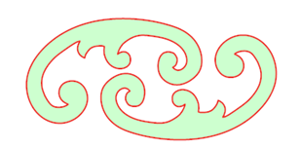
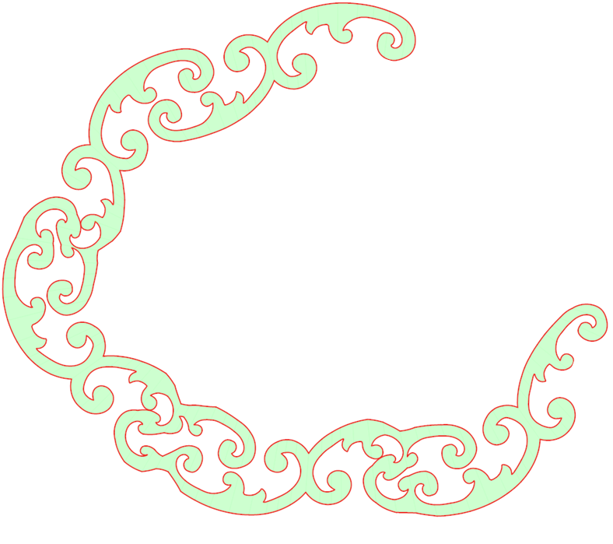
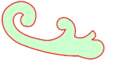
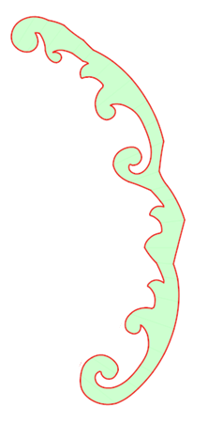
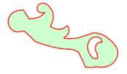
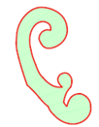
Example
Notes:
Existing techniques cannot guarantee that the object is fully connected,
and disconnected parts fall after fabrication

Slide 3
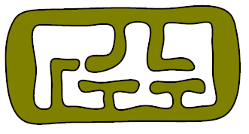
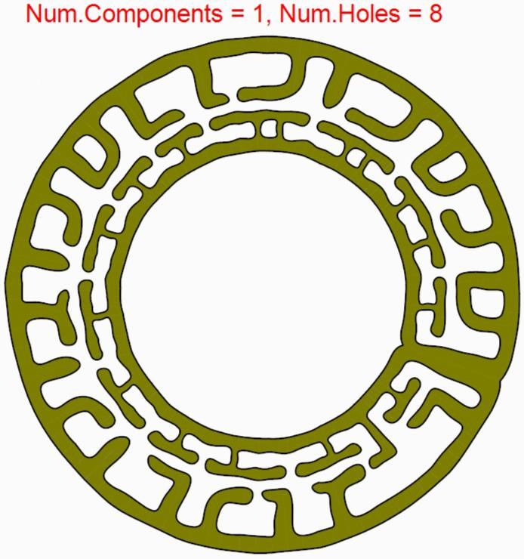
Connected
Pattern
Notes:
Our approach synthesizes vector patterns with controlled topology

Slide 4
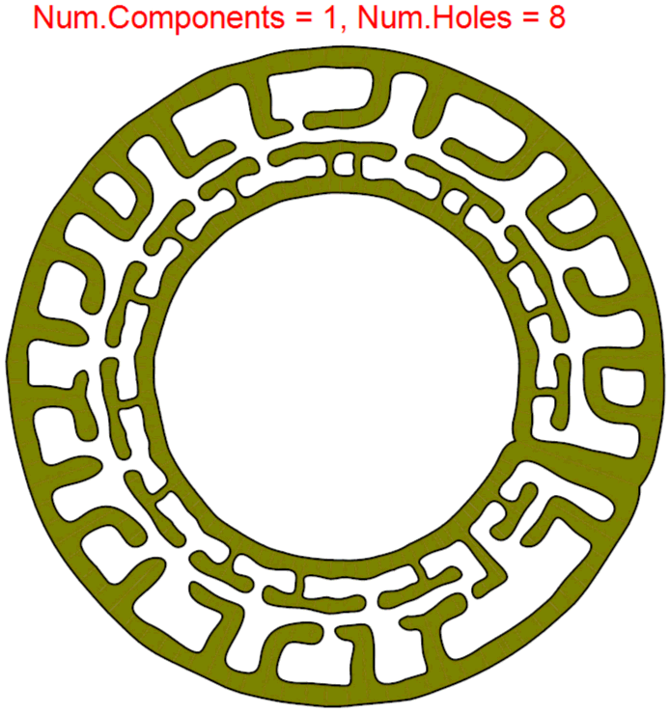
0
50
Controlling
its topology
Notes:
Here the number of disconnected components in the result is precisely controlled

Slide 5
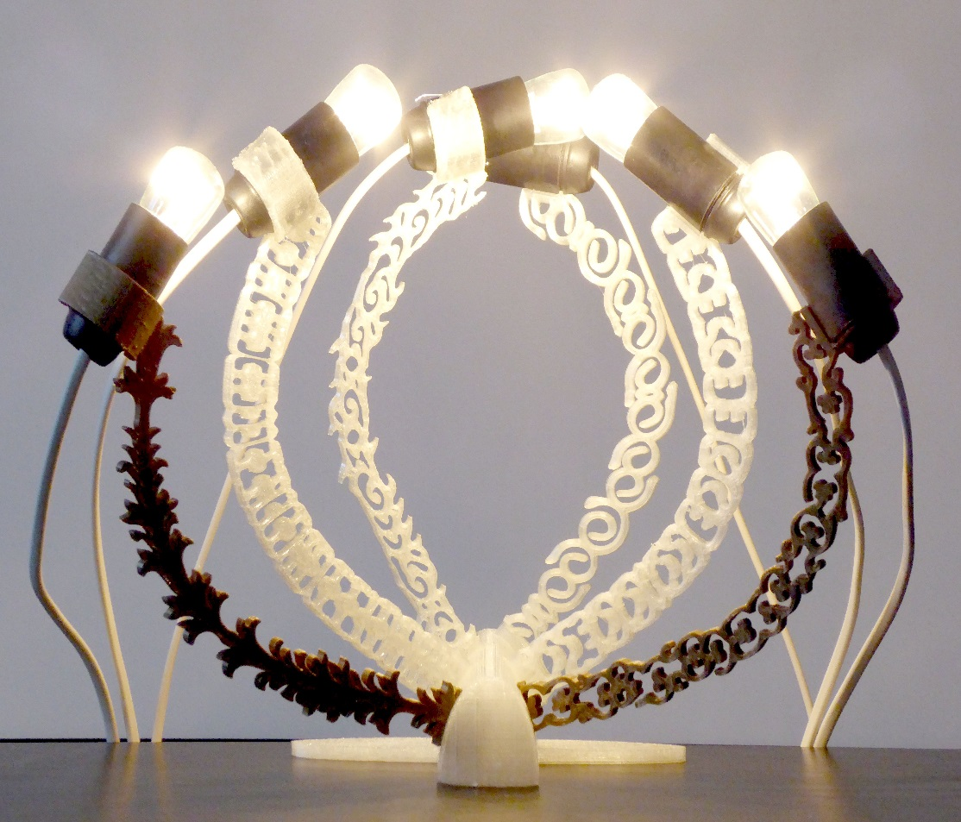
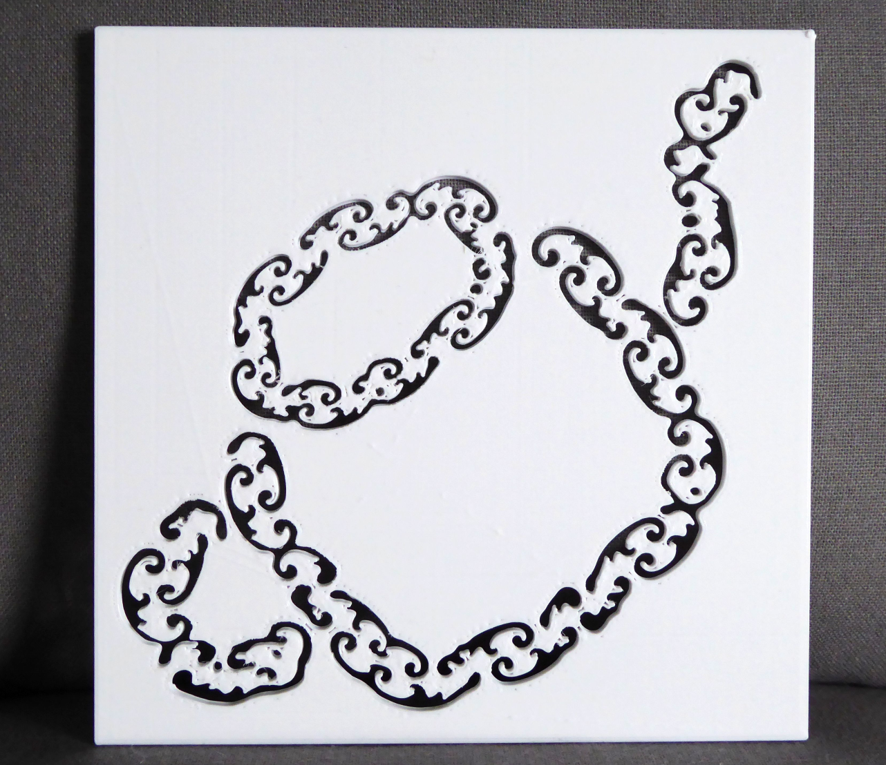
Notes:
This lets us fabricate a variety of novel, interesting designs.

